Slide 1
SkillSync: Adaptive Quiz Recommendation & Learning Analytics Platform
Phase 3: Integration & Delivery
Front end, database connectivity, testing and demonstration
Team members
Vani Singh (25BBS0115)
Soham Anup Hippalgaonkar (25BDS0201)
Chethan Kumar Konduru (25BAI0182)
Vishnuprasad AR (25BCB0143)
Course
BACSE202 Database Systems, VIT Vellore
Faculty
Dr. Somasundaram R

Slide 2
Recap
From Phase 2 to Phase 3
Phase | Delivered | Evidence
Phase 1 | EER model, relational schema, normalisation to 3NF | 10 tables, 12 foreign keys
Phase 2 | PostgreSQL DDL, sample data, business logic | 36 rows; functions, triggers, views
Phase 3 | Web front end, JDBC client, full CRUD, validation, tests, recommendations | 7 screens, 31 automated tests, pgvector
Phase 3 adds
A React web app and an Express API that read and write PostgreSQL on every screen.
Java JDBC and PowerShell ODBC clients that run the same retrieval, DML and business-logic functions.
Quiz taking graded inside the database, student sign-up, leaderboard and full edit/delete.
Similar-item recommendations with vector embeddings (pgvector), on top of weak-topic rules.
SkillSync · Phase 3 · 2

Slide 3
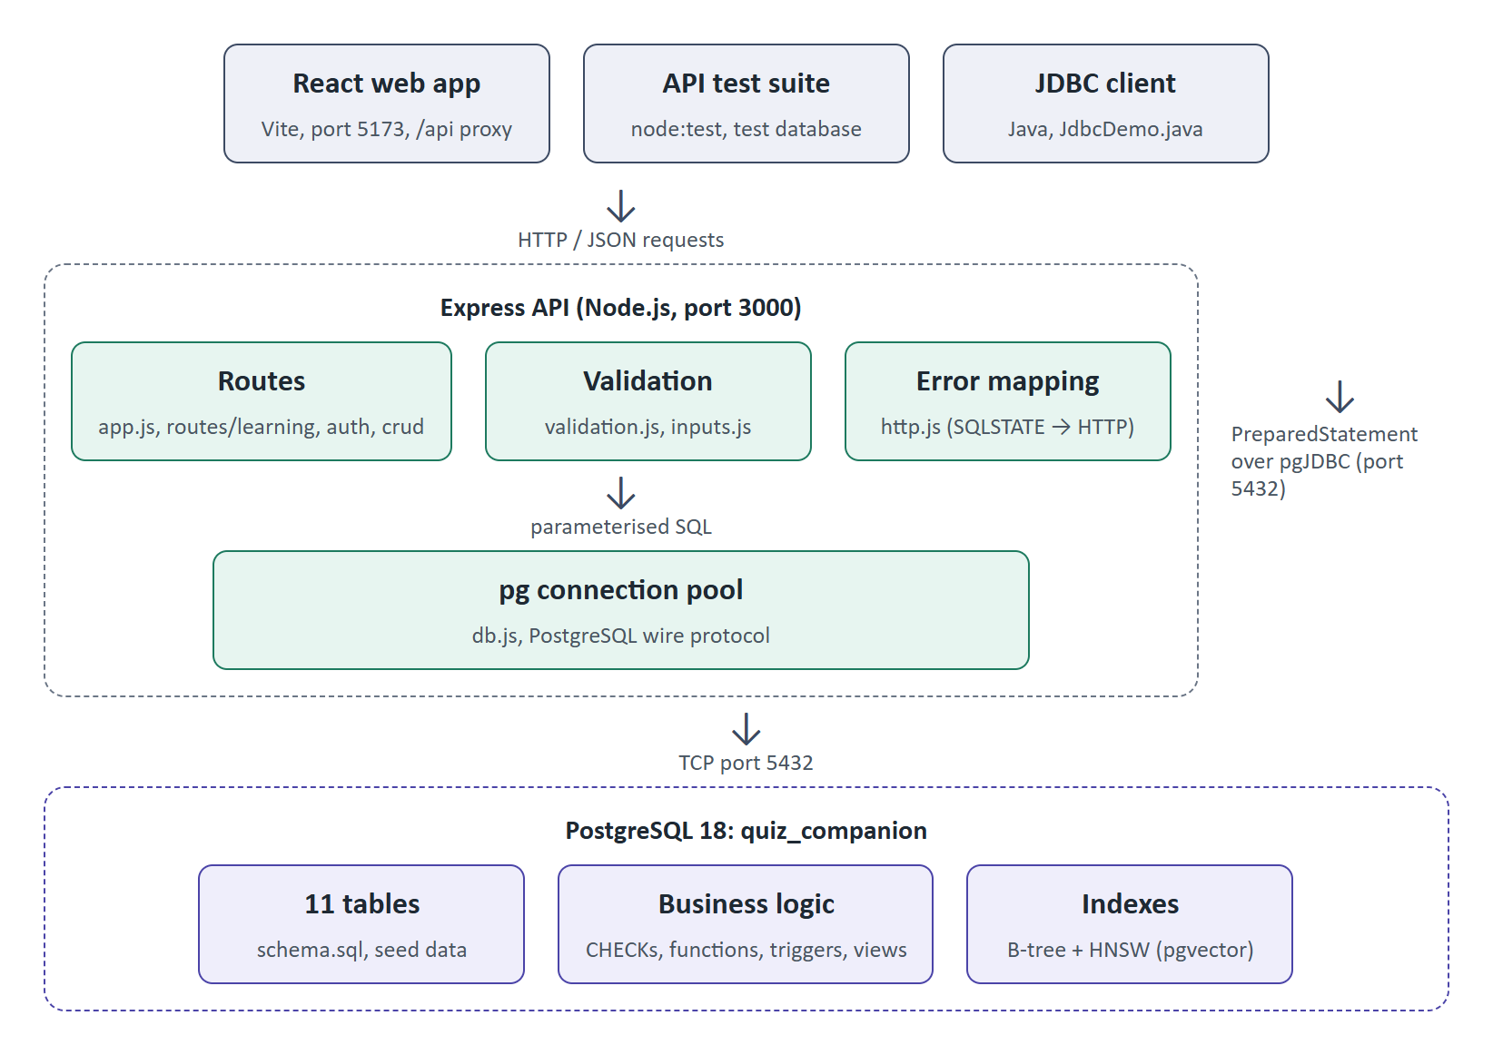
Part 9 · Database connectivity
Connectivity Architecture
Three tiers
React screens call an Express API over HTTP.
The API validates input and runs parameterised SQL through a node-postgres connection pool.
A Java client (JDBC) and a PowerShell client (ODBC) connect straight to PostgreSQL.
All rules live in the database, so every client behaves the same way.
SkillSync · Phase 3 · 3

Slide 4
Part 9 · Database connectivity
CRUD from the Front End
Operation | Screen / button | SQL executed (parameterised)
Create | Topics → Add topic | INSERT INTO topic (name, description, parent_topic_id) VALUES ($1, $2, $3)
Create | Learning Items → Add | INSERT INTO learning_item … + quiz or project + project_tech (one transaction)
Read | Dashboard | SELECT … FROM learning_record, topic_proficiency, recommendation WHERE user_id = $1
Update | Topics → Edit | UPDATE topic SET name = $2, description = $3, parent_topic_id = $4 WHERE topic_id = $1
Update | Dashboard → Done / Dismiss | UPDATE recommendation SET status = $3 WHERE user_id = $1 AND item_id = $2
Delete | Topics → Delete | DELETE FROM topic WHERE topic_id = $1 (guarded by a trigger)
Function | Quizzes → Submit | SELECT grade_quiz($1, $2::jsonb); SELECT record_attempt($1, $2, 'completed', $3)
Function | Account → Sign up | SELECT register_user($1, $2, $3) (password already hashed)
SkillSync · Phase 3 · 4

Slide 5
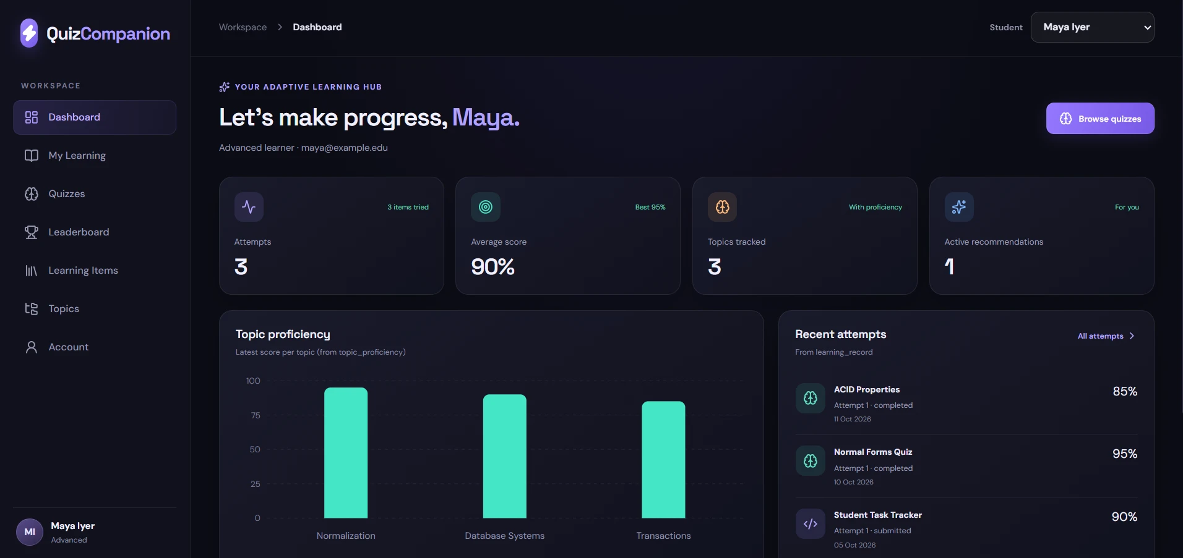
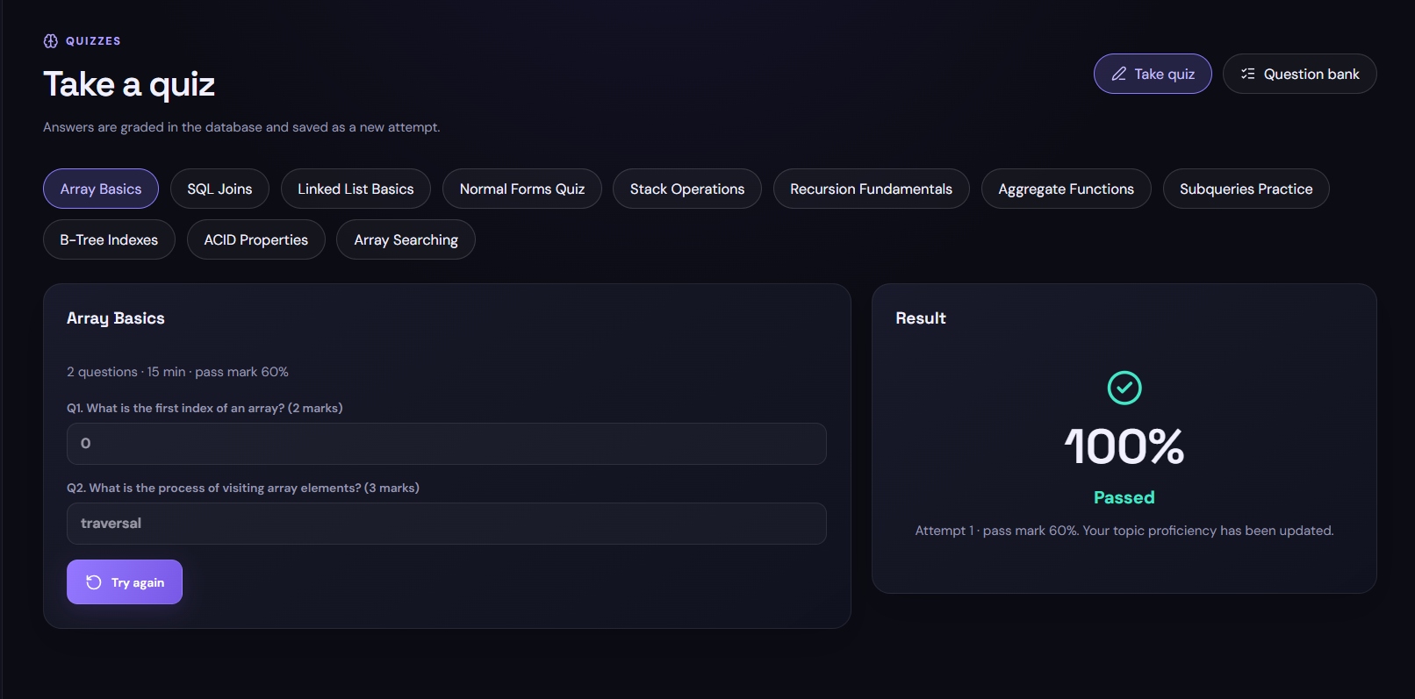
Part 7 · Front end
Front-End Screens on Live Data
Dashboard: attempts, proficiency chart, recent attempts
Take quiz: graded by grade_quiz() in the database
Seven screens: Dashboard, My Learning, Quizzes, Leaderboard, Learning Items, Topics, Account. Nothing is hard-coded: every number comes from the 11 PostgreSQL tables.
SkillSync · Phase 3 · 5

Slide 6
Part 8 · Business logic
What Happens When a Student Takes a Quiz
STEP 1
Submit answers
STEP 2
grade_quiz scores them
STEP 3
record_attempt saves it
STEP 4
Trigger updates proficiency
STEP 5
Result shown
→
→
→
→
Rule | What it does | Enforced by
Valid scores and dates | Score 0–100; status from a fixed list; no finish before start | CHECK constraints
Attempt numbering | Next attempt number is calculated, never typed; advisory lock prevents clashes | record_attempt()
Grading | Marks earned ÷ total marks × 100; pass if ≥ pass_mark | grade_quiz()
Proficiency | Latest scored attempt per topic; attempts counted | Trigger on learning_record
Leaderboard | Only each student's best score per item counts | View v_leaderboard
Protected topics | A topic that still has items cannot be deleted | Trigger on topic
SkillSync · Phase 3 · 6

Slide 7
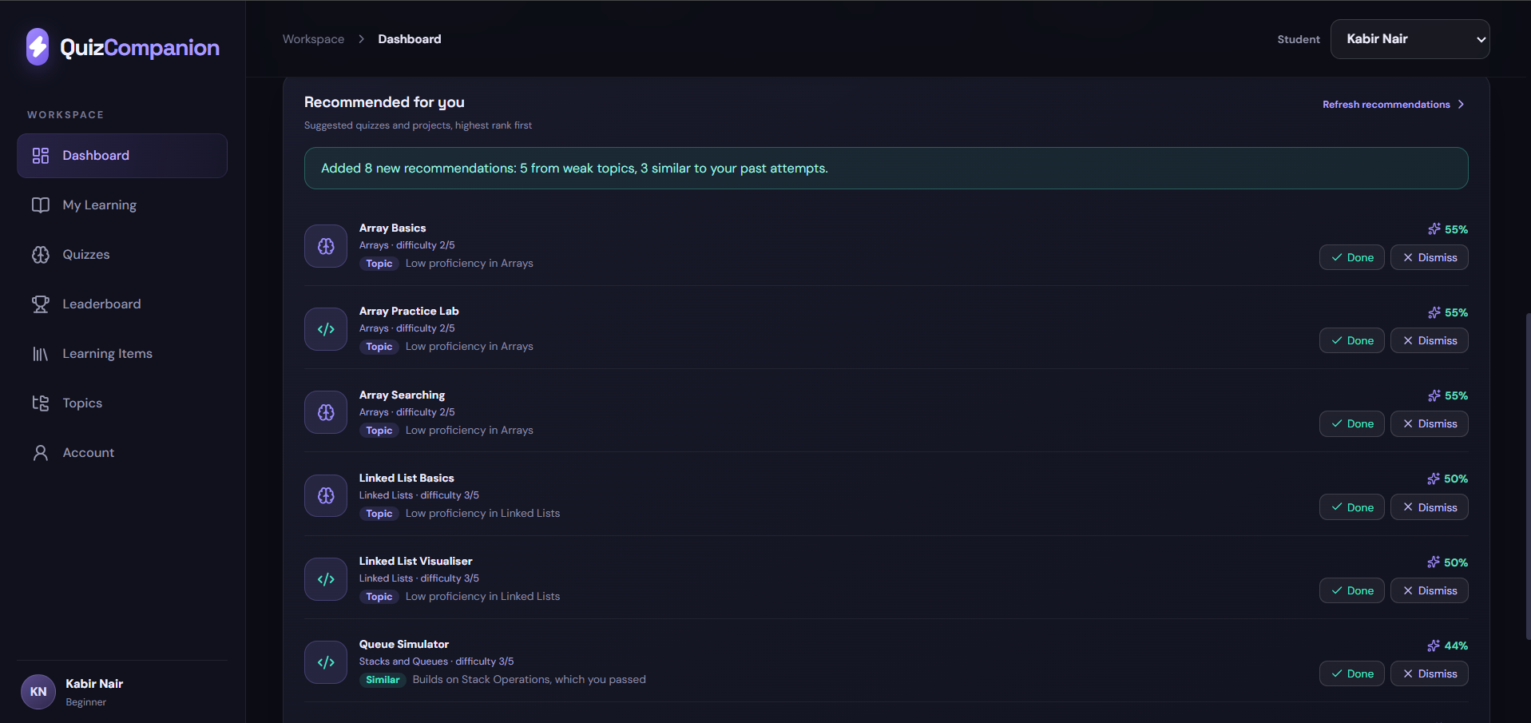
Part 8 · Business logic
Recommendations: Weak Topics and Vector Similarity
Two methods in one button
Topic: every item in a topic below 70, weakest first.
Similar: each item is a 384-number vector (all-MiniLM-L6-v2). A student's profile is the average of their attempts, weighted towards low scores.
Unattempted items closest to the profile are recommended, with a reason such as “Builds on Stack Operations, which you passed”.
pgvector keeps embeddings in PostgreSQL, so one SQL query joins them with attempts.
SkillSync · Phase 3 · 7

Slide 8
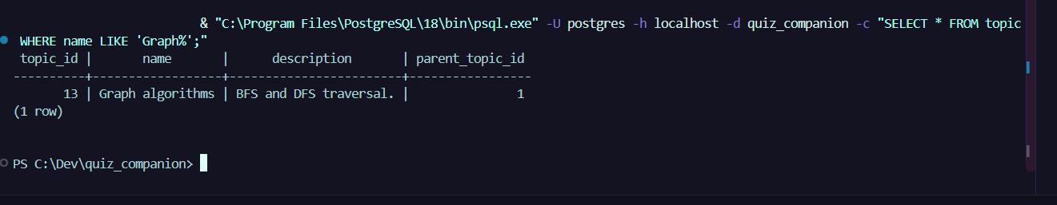
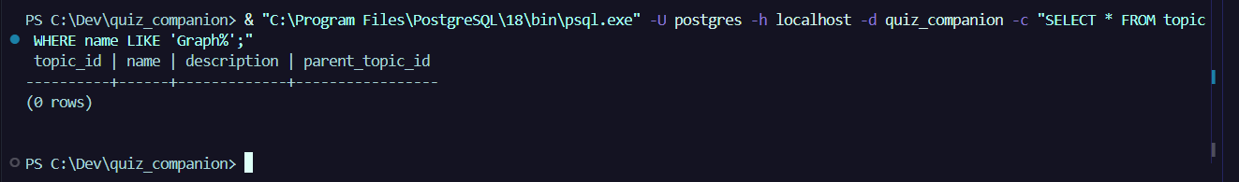
Part 9 · Database connectivity
Evidence: Create, Update and Delete
Create: row inserted from the Topics screen
Update: the new description is saved
Delete: no matching row remains
Each action was done in the running web app and checked with a SELECT in psql. The same operations run from Java through JDBC PreparedStatements; multi-table changes use one transaction.
SkillSync · Phase 3 · 8

Slide 9
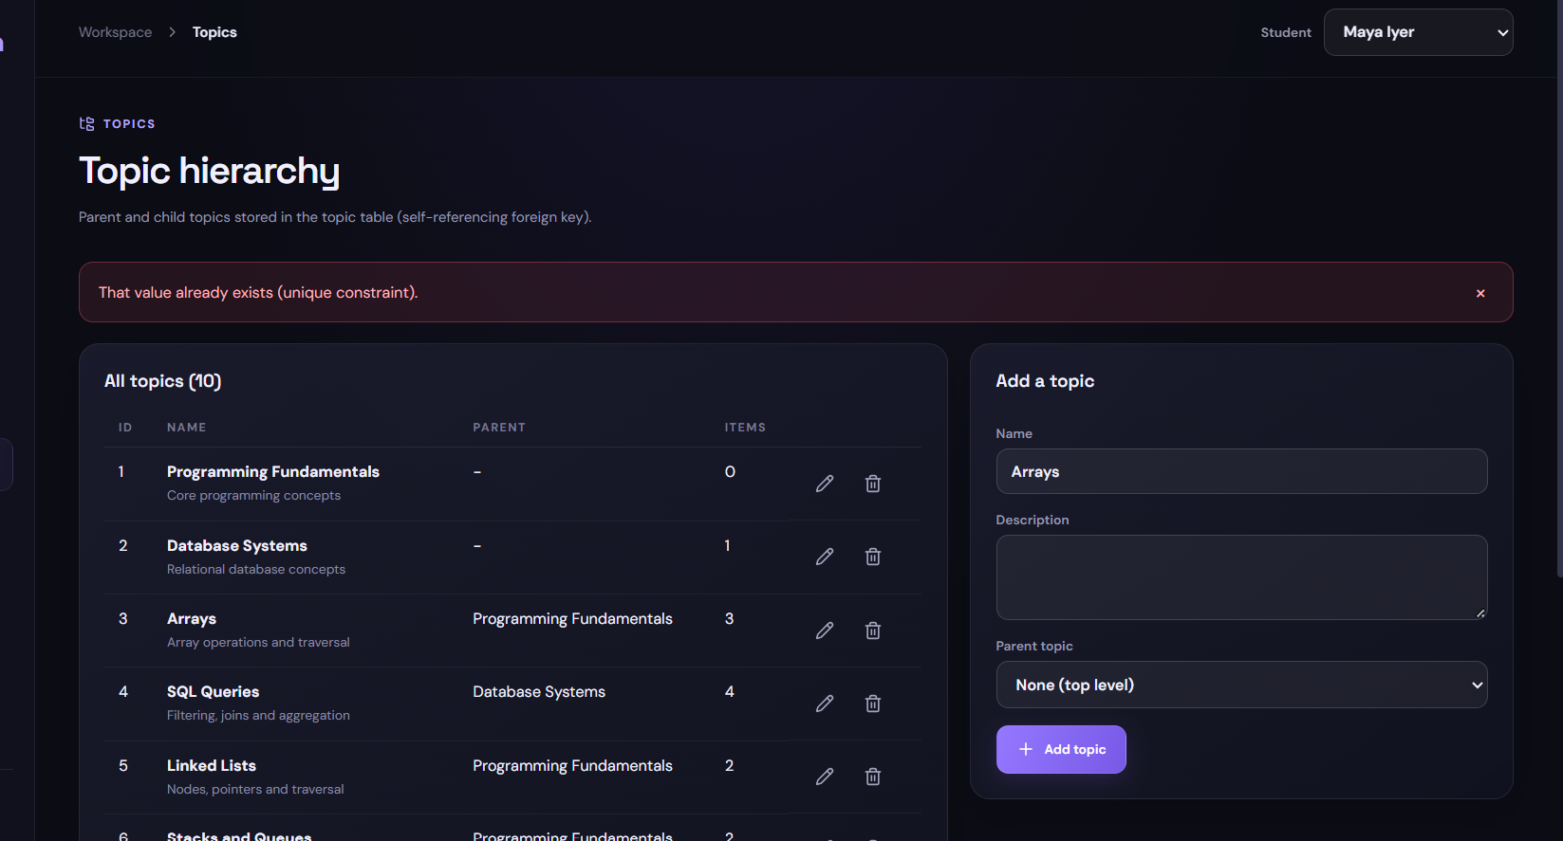
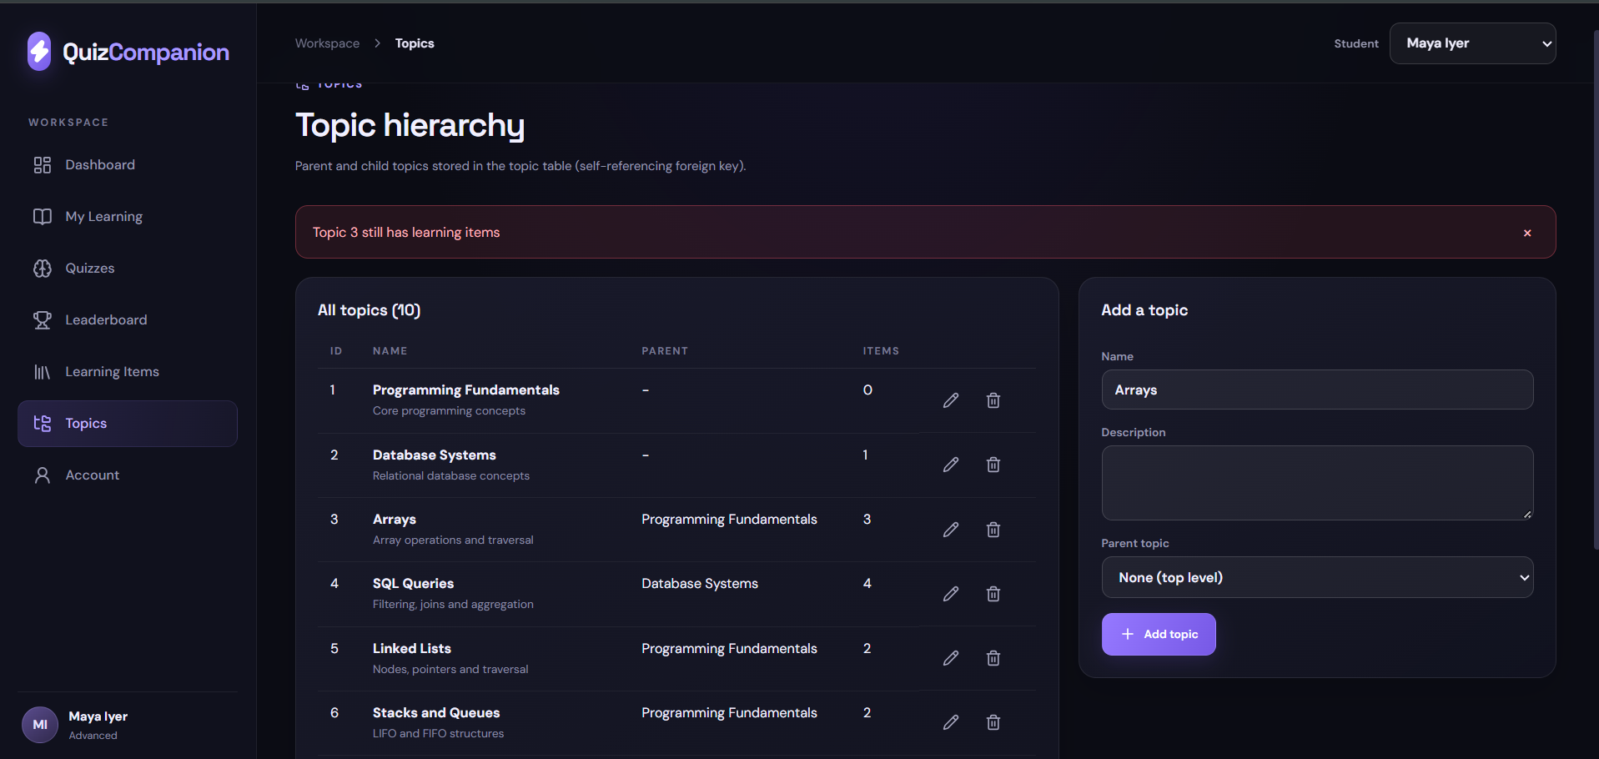
Part 10 · Testing and validation
Constraint Violations and Error Handling
UNIQUE violation: duplicate topic name
Trigger: topic still has learning items
SQLSTATE | Meaning | HTTP | Message
23505 | Unique violation | 409 | That value already exists (unique constraint).
23503 | Foreign key violation | 409 | Blocked by a related record (foreign key constraint).
23514 | Check violation | 400 | A value is outside the allowed range (check constraint).
SkillSync · Phase 3 · 9

Slide 10
Part 9 · Database connectivity
JDBC Client
String sql = "INSERT INTO topic (name, description,"
+ " parent_topic_id) VALUES (?, ?, ?)"
+ " RETURNING topic_id";
try (PreparedStatement st = db.prepareStatement(sql)) {
st.setString(1, name);
st.setString(2, description);
st.setObject(3, parentId);
ResultSet rs = st.executeQuery();
}
// grade and record in one transaction
db.setAutoCommit(false);
SELECT grade_quiz(?, ?::jsonb)
SELECT record_attempt(?, ?, 'completed', ?::numeric)
db.commit(); // db.rollback() on error
jdbc/JdbcDemo.java
PostgreSQL JDBC driver 42.7.4, Java 21.
Menu: list, add, rename and delete topics; list items; take a quiz; leaderboard.
--demo runs every operation in turn, including a rejected delete.
Password comes from DB_PASSWORD or a prompt, never from source code.
SkillSync · Phase 3 · 10

Slide 11
Part 9 · Database connectivity
ODBC Client
$driver = Get-OdbcDriver -Platform '64-bit' |
Where-Object Name -like '*UNICODE*'
$cs = "Driver={$($driver.Name)};Server=localhost;"
+ "Port=5432;Database=quiz_companion;Uid=postgres;Pwd=..."
$db = New-Object System.Data.Odbc.OdbcConnection($cs)
$db.Open()
# parameterised INSERT
INSERT INTO topic (name, description, parent_topic_id)
VALUES (?, ?, ?) RETURNING topic_id
# grade and record in one transaction
SELECT grade_quiz(?, CAST(? AS jsonb))
SELECT record_attempt(?, ?, 'completed', CAST(? AS numeric))
$tx.Commit() # $tx.Rollback() on error
odbc/OdbcDemo.ps1
PostgreSQL ODBC driver (psqlODBC, Unicode, 64-bit) through System.Data.Odbc.
Same menu and -Demo run as the JDBC client.
The demo ends with a rejected delete: trigger error 23001 “Topic 3 still has learning items”.
The quiz attempt is rolled back, so the sample data stays unchanged.
SkillSync · Phase 3 · 11

Slide 12
Part 10 · Testing and validation
Test Strategy and Results
Category | Total | Passed | Failed
Functional | 9 | 9 | 0
Constraint violation (incl. triggers, functions) | 10 | 10 | 0
Error handling | 4 | 4 | 0
Total documented cases | 23 | 23 | 0
PASS connectivity and retrieval
PASS topics CRUD
PASS learning items CRUD
PASS questions CRUD
PASS business rules through the API
PASS accounts and users
PASS error handling
PASS vector recommendations
tests 31
pass 31
fail 0
Three levels
SQL: business_logic_tests.sql, rolled back.
API: 31 automated tests on a separate, rebuilt test database.
Front end, JDBC and ODBC: each run with valid and invalid input.
One case failed first (NOW() vs TIMESTAMPTZ) and passed after the fix.
SkillSync · Phase 3 · 12

Slide 13
Results
Scope Achieved Against Phase 1
Module (Phase 1 scope) | Status | Remarks
Topics, quizzes, projects, questions | Completed | Full CRUD from the front end
Quiz taking and grading | Completed | grade_quiz() and record_attempt() in one transaction
Attempt history and topic proficiency | Completed | Maintained by trigger trg_update_proficiency
Recommendations | Completed | Weak-topic rule plus pgvector similarity (replaces Qdrant)
Leaderboard | Completed | View v_leaderboard
Student accounts | Partly | Sign-up and sign-in with hashed passwords; no sessions or roles yet
Caching of frequent reads (Redis) | Not built | Indexes added instead; not needed at this data size
Database connectivity | Completed | node-postgres for the web app; JDBC and ODBC console clients
SkillSync · Phase 3 · 13

Slide 14
Demonstration
Live Demo Flow
STEP 1
Sign up
STEP 2
Take a quiz
STEP 3
See proficiency
STEP 4
Refresh recommendations
STEP 5
Leaderboard
→
→
→
→
Then show the database side
psql: SELECT the new attempt and the updated topic_proficiency row.
Topics: add, edit, delete, then try to delete Arrays to show the trigger message.
Java and ODBC: run JdbcDemo --demo and OdbcDemo.ps1 -Demo; the same functions are called.
Terminal: npm test, 31 of 31 passing.
SkillSync · Phase 3 · 14

Slide 15
Conclusion
Conclusion and Future Enhancements
Area | Phase 3 outcome
Design to delivery | Phase 1 EER and 3NF schema implemented in PostgreSQL and used by a working application
Connectivity | Web app through node-postgres; Java client through JDBC; PowerShell client through ODBC; all CRUD operations
Database logic | Constraints, functions, triggers and views enforce every rule for every client
Quality | 23 documented test cases, 31 automated tests, all passing
Beyond the plan | pgvector similarity recommendations; indexes on foreign keys
Next
Session tokens and role-based access · enforced quiz time limits · Redis leaderboard cache at scale · automatic recommendations after every attempt.
SkillSync · Phase 3 · 15

